Slide 1
Believe in the Good Public Perceptions Poll
Believing in Nonprofits

Slide 2
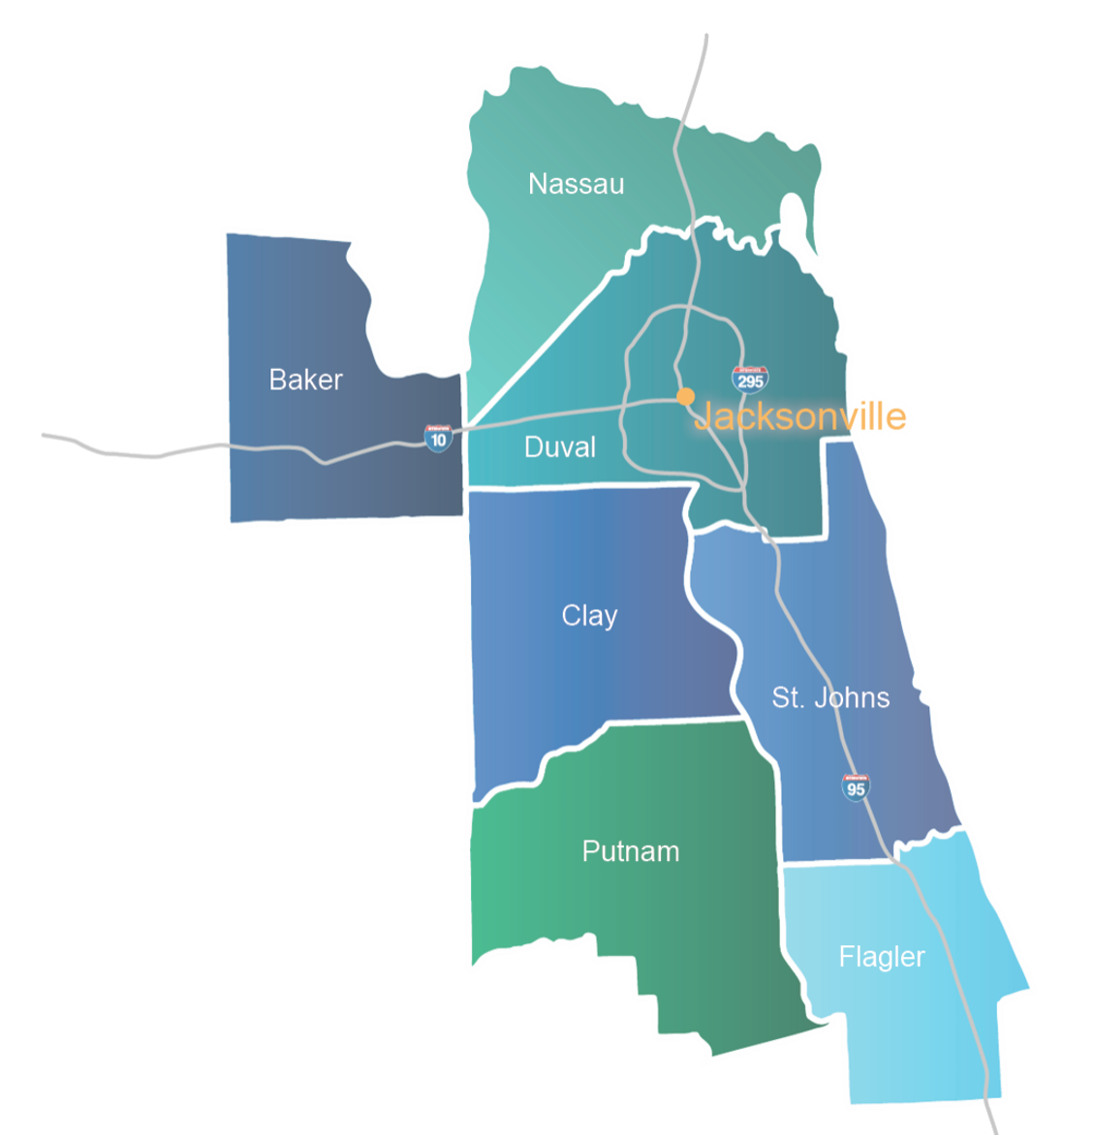
A Community That Believes in the Good
Fall 2022 poll conducted by the University of North Florida Public Opinion Research Lab in the seven-county region of 1,023 people.
Public trust in institutions
Attitudes about nonprofits
Contributions of time, talent, and treasure to nonprofits

Slide 3
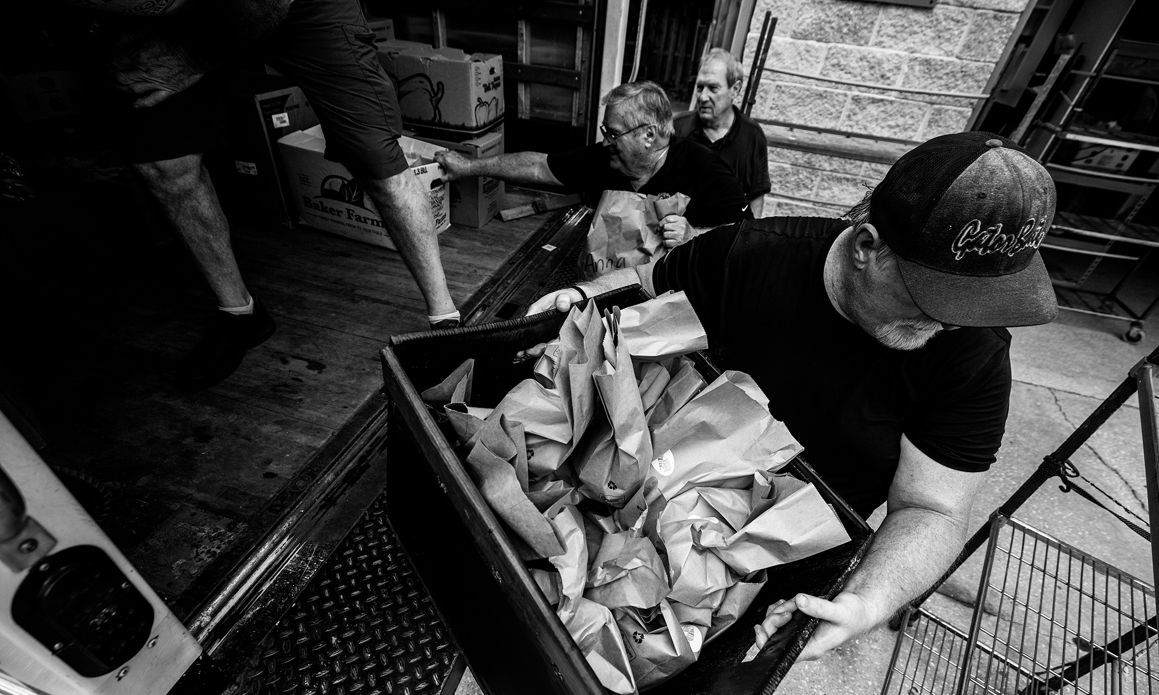
Beliefs About Nonprofits
80%
of Northeast Florida residents agree that our community would be a better place to live if more people gave money or volunteered to help nonprofits.
Notes:
The results incontrovertibly tell us that our community believes in the good that nonprofits can do. 8 in 10 people say our community would be a better place to live if more people donated or volunteered with nonprofits

Slide 4
Positive Perceptions of Nonprofits
Deliver services more efficiently than government
Make our community more desirable
Vital part of our economy
Nonprofit Center of Northeast Florida
Notes:
And they say that nonprofits:
Can deliver services more efficiently than government;
Make our community more desirable; and
Are a vital part of our economy.

Slide 5
Belief in Nonprofit Efficiency
Government should provide more funding
Nonprofits are well-run
Working in nonprofits is a worthwhile career
Nonprofit Center of Northeast Florida
Notes:
Plus, three quarters of people believe that government should provide more funding to nonprofits, that non-profits are run by dedicated professionals with a businesslike approach to management, and that working in the nonprofit sector is a worthwhile career path.

Slide 6
Positive Changes in Beliefs
2011
2022
Nonprofit Center of Northeast Florida
Notes:
Right around the time of the Nonprofit Center’s 10th anniversary, and in the wake of the recession of 2009, we issued a first-of-its-kind survey about perceptions of the local nonprofit sector. This poll found that ALL of these indicators have significantly improved since then.
And looking across institutions in our community, individual volunteers and nonprofits are among the most trusted in our community.
This is all great news.
But we also know that we live in difficult times. In fact, no one knows it better than our local nonprofits and the people they activate and serve. Two years after Covid-19 rocked all of our worlds, we are seeing the impact of global trends in our local community, both in terms of the challenges facing individuals and families, and challenges facing our civic life, democracy, and the fabric of our interconnectedness.

Slide 7
Rates of Volunteering and Donating
Nonprofit Center of Northeast Florida
Notes:
Reported rates of donating and volunteering activities are down from 2011, though similar to what is seen in the statewide averages.
Nationally over the last decade-plus, Pew research has found that confidence in institutions of all sorts is at a historic low. I’m sorry to tell you that Northeast Florida has not been immune to diminishing trust in institutions, and nonprofits and individual volunteers are among them.

Slide 8
Trust in Institutions
Individual Volunteers
Military
Local Nonprofit Orgs
Police
Businesses
Churches & Faith Orgs
Colleges & Universities
Local Government
Local School Boards
State Government
Philanthropy
Federal Government
Notes:
A number of factors impacted this, from the Great Recession and financial crisis, increasing partisan gridlock in Washington, a resurgence of populism, the COVID-19 pandemic, and inflation rates not seen for four decades.
While nonprofits and individual volunteers remain among the most trusted institutions in our community, that trust has fallen and among nonprofits, there is an opportunity to tap into existing positive perceptions to solidify mild support into strong support.
That challenge is both easier and more difficult than ever before in an information ecosystem that is dramatically different than it was 10 years ago, and in a time of escalated political polarization.
The poll has a lot of detailed information, and the report, charts, and crosstabs are all available at nonprofitctr.org, and we invite you to download and use them as you formulate your organization’s communications strategy.

Slide 9
Trust in Institutions
Notes:
A number of factors impacted this, from the Great Recession and financial crisis, increasing partisan gridlock in Washington, a resurgence of populism, the COVID-19 pandemic, and inflation rates not seen for four decades.
While nonprofits and individual volunteers remain among the most trusted institutions in our community, that trust has fallen and among nonprofits, there is an opportunity to tap into existing positive perceptions to solidify mild support into strong support.
That challenge is both easier and more difficult than ever before in an information ecosystem that is dramatically different than it was 10 years ago, and in a time of escalated political polarization.
The poll has a lot of detailed information, and the report, charts, and crosstabs are all available at nonprofitctr.org, and we invite you to download and use them as you formulate your organization’s communications strategy.

Slide 10
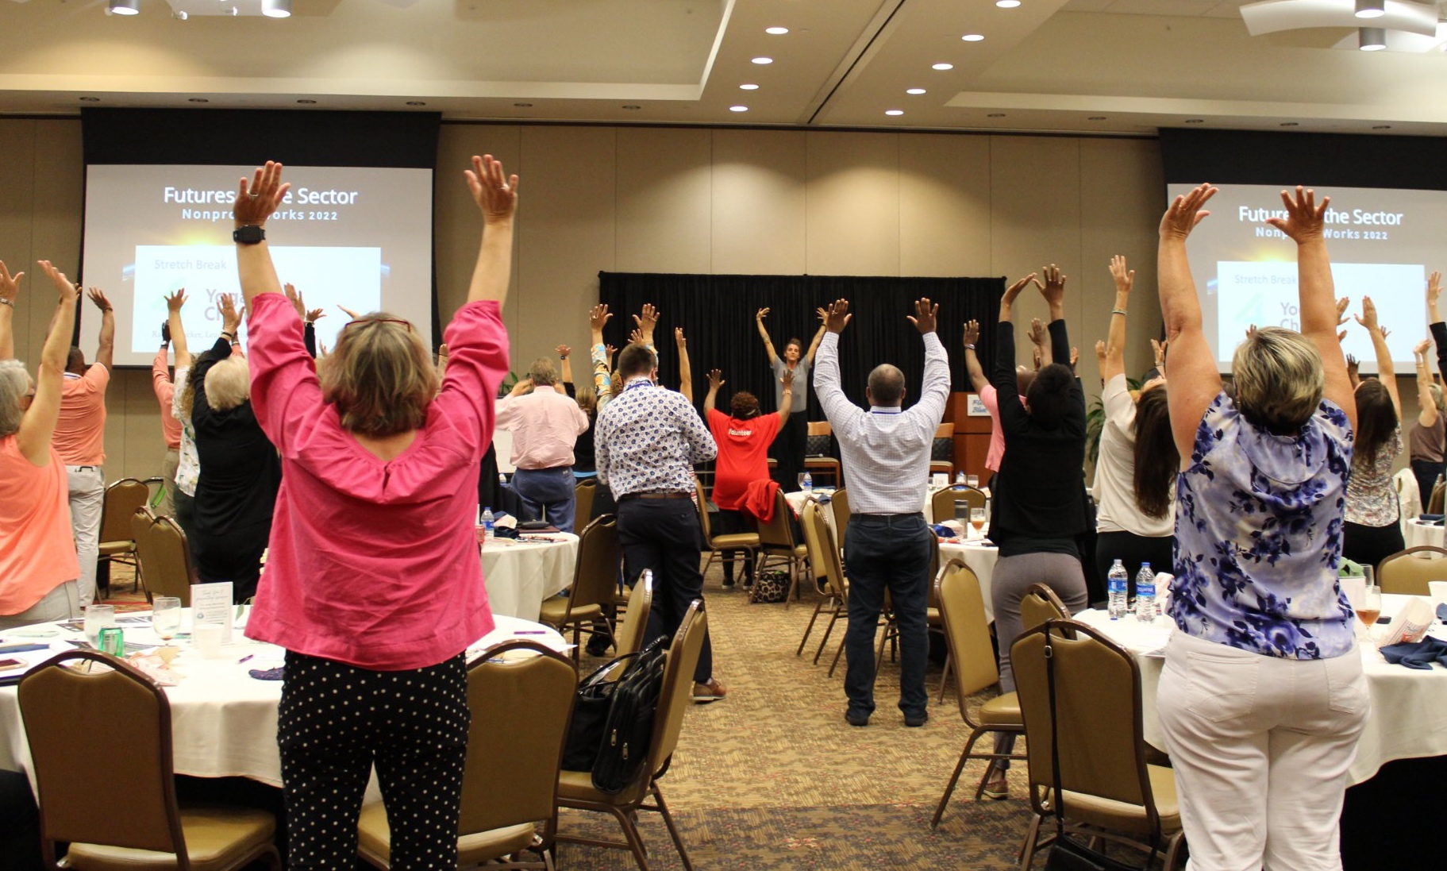
Looking Ahead
77%
believe the work nonprofits do creates a fairer, more unified community.
Notes:
At the Nonprofit Center, we found a lot of reasons for hope in these numbers despite the challenging environment that we are all operating in.
The first is the promise that nonprofits hold to fight the tide of polarization, misinformation, and ugliness in the public discourse and instead bring our community together in new and profound ways. The poll told us that the vast majority of people — 77 percent — believe the work that nonprofits do creates a fairer, more unified community. This view of nonprofits as a unifier holds the key to making real the vision for a vibrant, inclusive Northeast Florida.

Slide 11
Looking Ahead
Notes:
Another is that the data reveals levels of volunteerism and donations are high in the youngest adults, holding so much promise to activate a new generation of changemakers.
Finally, we know that despite declines in trust, majorities across a wide variety of demographic differences, including age, race, gender, income, and party affiliation.
In many ways, people in our community are primed and ready to believe in the good, and now it’s time for nonprofits to step into their power as the place where that good is channeled, honed, and spread to ensure everyone in our region can reach their full potential.

Slide 12
Thank you!

